Slide 1
Mining Patterns in Source Code using
Tree Mining Algorithms
Hoang Son Pham¹, Siegfried Nijssen¹, Kim Mens¹,
Dario Di Nucci², Tim Molderez², Coen De Roover²,
Johan Fabry³, and Vadim Zaytsev³
¹ ICTEAM, UCLouvain, Belgium
² Software Languages Lab, VUB, Belgium
³ Raincode Labs, Belgium
AIA meeting, 8th May, 2019

Slide 2
Outline
Introduction
Frequent tree mining
Problem statement
Constraint-based maximal tree mining
..
Related work
Conclusion and future work

Slide 3
Introduction
Maintain and develop big software projects are complicated tasks
Software engineers need intelligent support systems
Many design and code conventions get encoded in source code: coding idioms, usage protocols
Software engineers can obtain valuable information from these regularities

Slide 4
Examples of patterns in source code
Coding idioms
Programming language structures, i.e., for-statement
for (Figure figure : selectedFigures) {…}
Code repeated among different classes
protected void updateEnabledState() {
if (getView() != null) {
setEnabled(...);
} else {
setEnabled(false);
}
}

Slide 5
Examples of patterns in source code:
Usage protocols
Methods always appear paired:
f.fileOpen();
...
f.fileClose();
figure.willChange();
…
figure.changed();

Slide 6
Examples of patterns in source code
Usage protocols
A set of methods implemented on several classes
UndoableEdit edit = new AbstractUndoableEdit() {
@Override
public String getPresentationName() {
...
}
@Override
public void undo() {
super.undo();
Iterator<Object> iRestore = restoreData.iterator();
...
}
@Override
public void redo() {
super.redo();
...
}
};

Slide 7
Applications
To help software engineers to understand, analyze, maintain and improve the system
To build code recommendation system or code completion tool

Slide 8
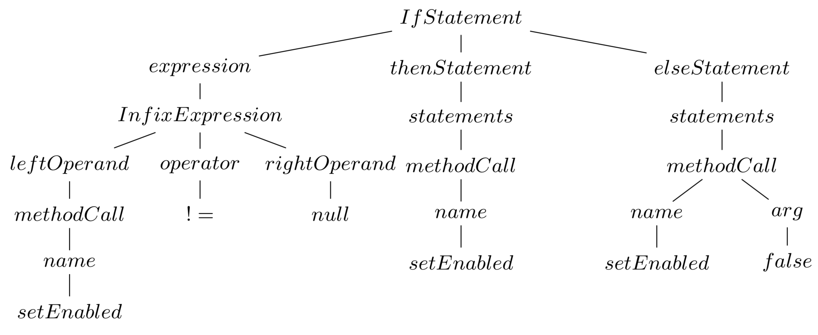
Source code patterns
Source code pattern
Source code are represented by Abstract Syntax Trees (ASTs).
Source code patterns correspond to fragments of trees that occur frequently
Discover source code patterns by using frequent tree mining algorithms
protected void updateEnabledState() {
if (getView() != null) {
setEnabled(...);
} else {
setEnabled(false);
}
}
Tree representation

Slide 9
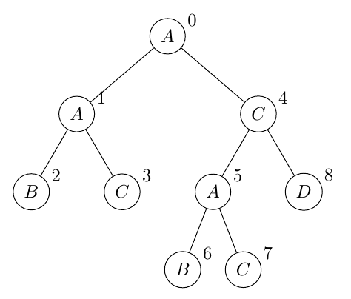
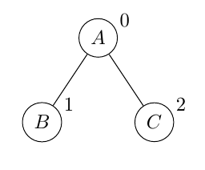
Frequent tree mining
Tree data: labeled, ordered, rooted trees
Matching ordered tree: induced subtree
Support of subtree: the number of trees in a database in which the subtree occurs
Frequent tree mining: discover all frequent subtrees in a given tree data.
Tree data
Induced subtree

Slide 10
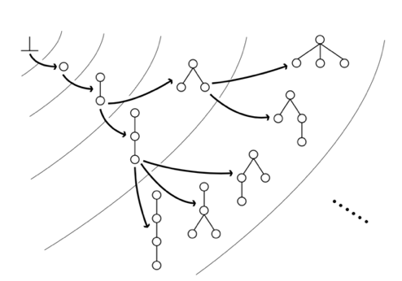
FREQT algorithm
Search patterns: depth-first search
Grow patterns: rightmost path extension
Prune: minimum support
Problem:
- does not scale for source code mining
- produces a large amount of useless patterns

Slide 11
Problem statement
Interesting patterns in source code:
  Reflect structure of programming language
  The total number of nodes/leafs in a pattern is sufficiently large

Slide 12
Problem statement
Combine constraint-based data mining and maximal frequent tree mining algorithm to
  find patterns with size as large as possible
  reduce number of output patterns
  reduce execution time

Slide 13
Constraint-based maximal tree mining
1: Minimum size constraints
  C1: the number of leafs in a pattern is sufficiently large
  C2: the total number of nodes in a pattern is sufficiently large
2: Constraints on labels
  C3: limit the set of labels allowed to occur in the root of patterns
  C4: provide labels forbidden from occurring in the pattern
  C5: limit the number of siblings in a pattern that can have the same label

Slide 14
Constraint-based maximal tree mining
3: Constraint on leafs
  C6: All leaf nodes in a pattern must have a label that is included in leafs of data
4: Obligatory children
  Given a node, some of its children can be mandatory
  C7: do not allow to produce patterns that missing mandatory labels

Slide 15
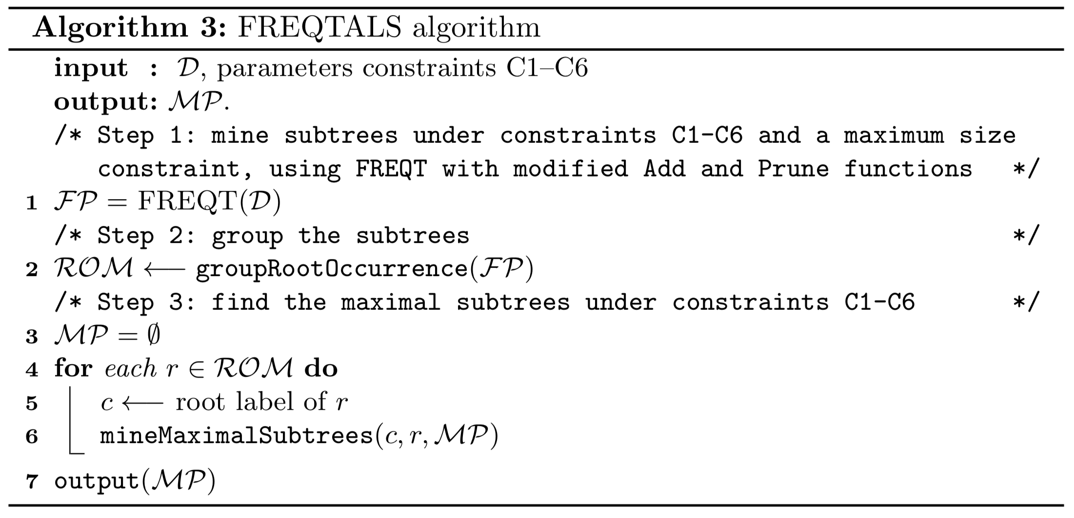
FREQTALS algorithm

Slide 16
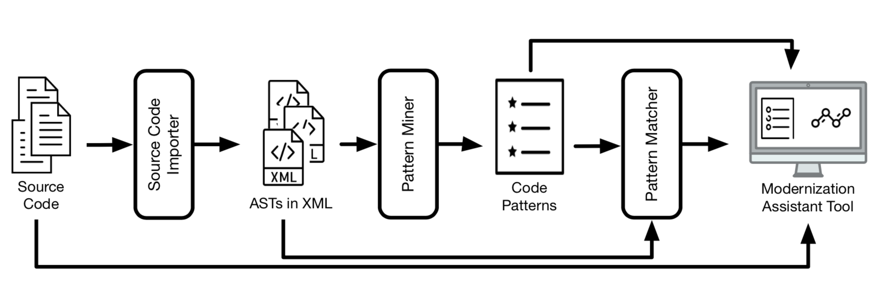
The modular language-parametric framework for mining code regularities

Slide 17
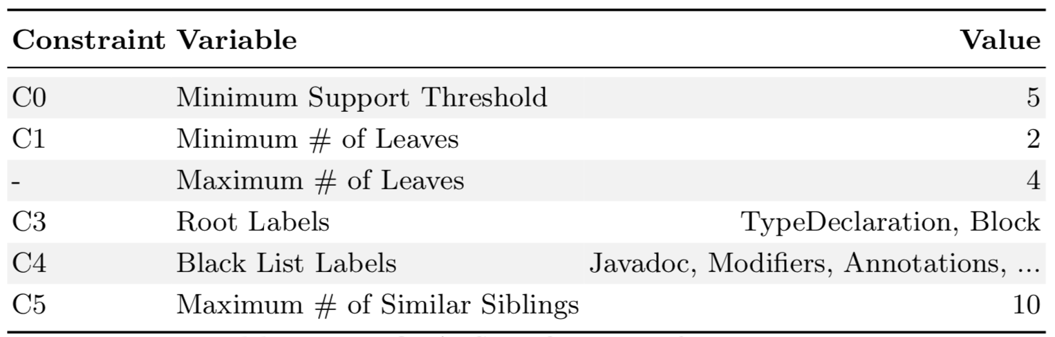
Experiments
Dataset: Java source code (Jhotdraw project)
Configurations:

Slide 18
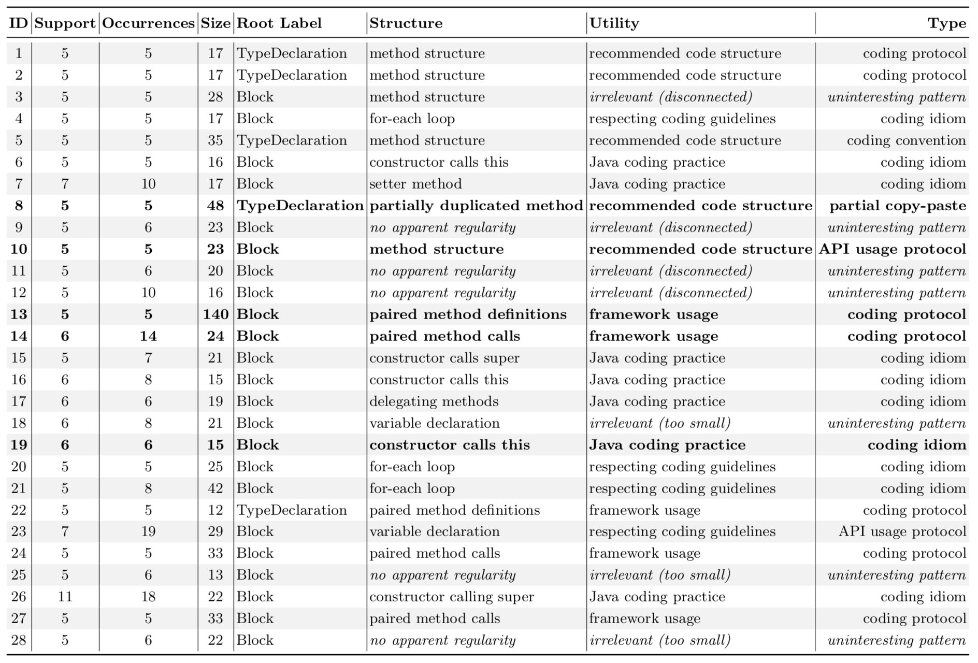
Qualitative Analysis

Slide 19
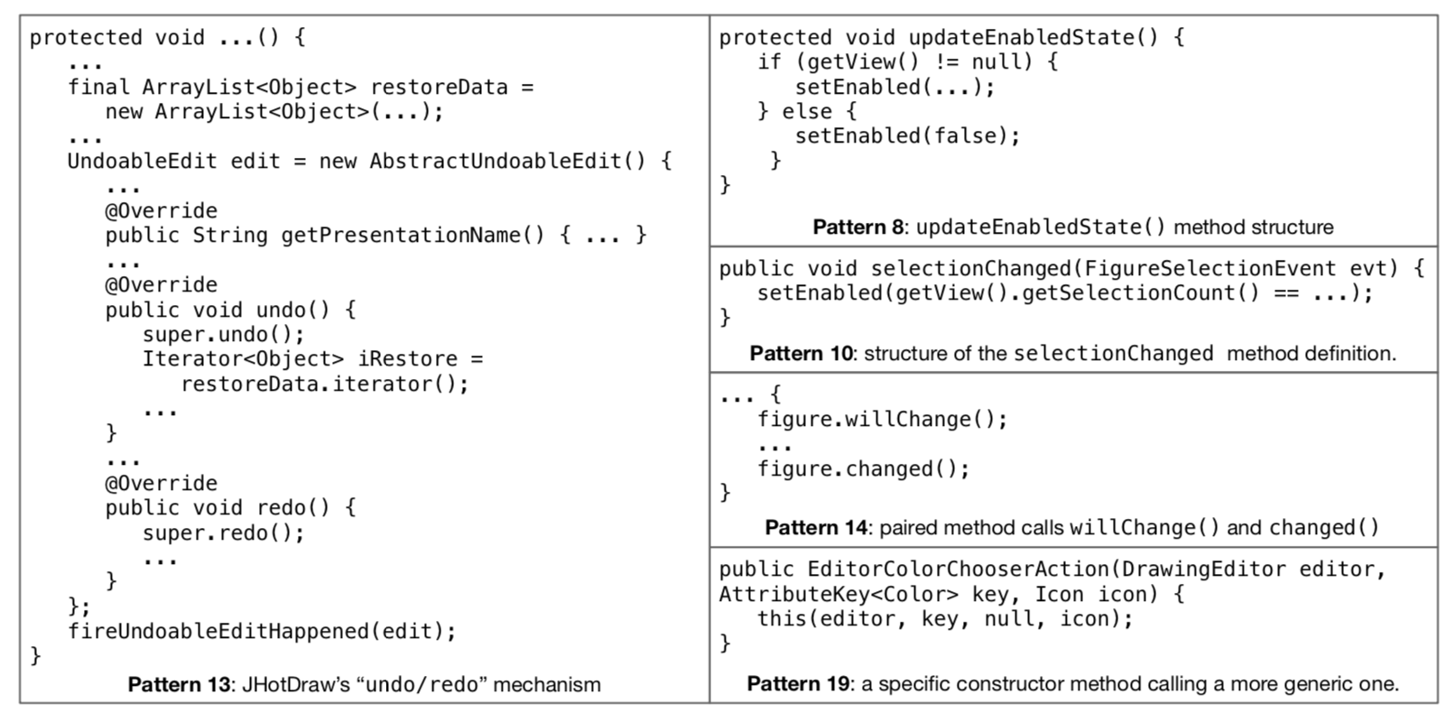
Qualitative Analysis

Slide 20
Comparison between Original FREQT and FREQTALS

Slide 21
Comparison between Original FREQT and FREQTALS
Algorithm | Frequent Patterns | Running time
FREQTALS with extensions | 1,280 | 2.21 seconds
Original FREQT with minsup constraint | 42,430 | Timeout (5 minutes)

Slide 22
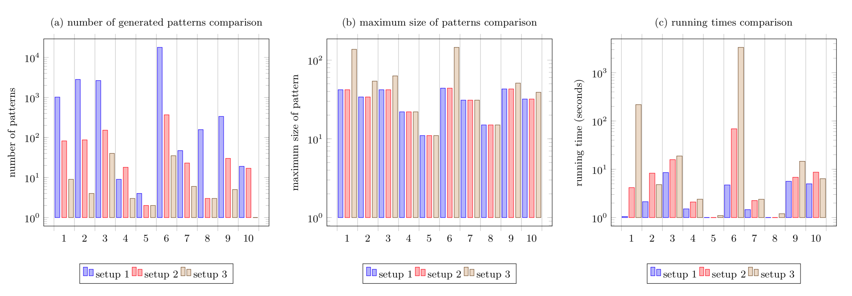
Evaluate the extensions of FREQTALS
Setup 1: applies only step 1, with a maximal size constraint
Setup 2: filters maximal patterns from result of step 1
Setup 3: applies all steps to find maximal patterns without maximal size constraint

Slide 23
Related work

Slide 24
Conclusion and future work
Contributions of FREQTALS algorithm:
  the discovered patterns highlight relevant code regularities;
  the patterns found are significantly larger;
  the execution time and amount of output patterns are significantly smaller for the same minsup;
  the configurations are easily adapted for other programming languages.

Slide 25
Future work
Employ FREQTALS on legacy programming languages;
Explore more details of the quality of patterns;
Improve the scalability;
Define guidelines to setup configurations.

Slide 26
Thank you very much!

